Slide 1
STATE DIAGRAM AND ACTIVITY DIAGRRAMS

Slide 2
State Diagrams
A state diagram describes the behaviour of a system, some part of a system, or an individual object.
At any given point in time, the system or object is in a certain state.
Being in a state means that it is will behave in a specific way in response to any events that occur.
Some events will cause the system to change state.
In the new state, the system will behave in a different way to events.
A state diagram is a directed graph where the nodes are states and the arcs are transitions.

Slide 3
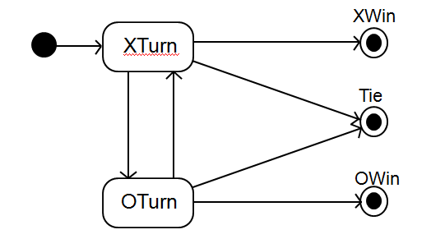
State diagrams – an example
tic-tac-toe game

Slide 4
States
At any given point in time, the system is in one state.
It will remain in this state until an event occurs that causes it to change state.
A state is represented by a rounded rectangle containing the name of the state.
Special states:
A black circle represents the start state
A circle with a ring around it represents an end state

Slide 5
Transitions
A transition represents a change of state in response to an event.
It is considered to occur instantaneously.
The label on each transition is the event that causes the change of state.
A transition is rendered as a solid directed line.

Slide 6
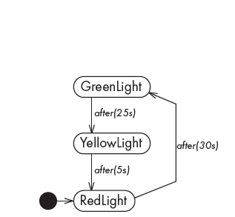
State diagrams – an example of transitions with time-outs and conditions
State diagrams of a simple traffic light, illustrating elapsed-time transitions

Slide 7
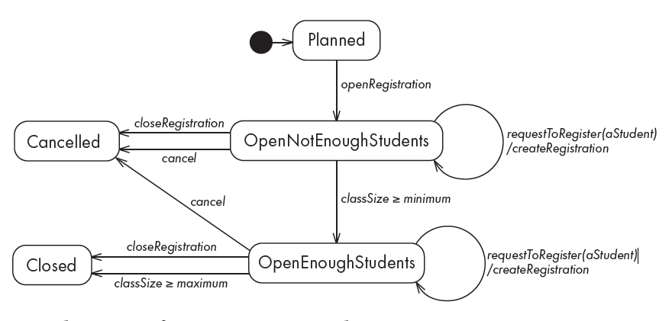
State diagrams – an example with conditional transitions
State diagram of a CourseSection class

Slide 8
Activities in state diagrams
An activity is something that takes place while the system is in a state.
It takes a period of time.
The system may take a transition out of the state in response to completion of the activity,
Some other outgoing transition may result in:
The interruption of the activity, and
An early exit from the state.

Slide 9
Activity representation
An activity is shown textually within a state box by the word ‘do’ followed by a ‘/’ symbol, and a description of what is to be done.
When you have details such as actions in a state, you draw a horizontal line above them to separate them from the state name.

Slide 10
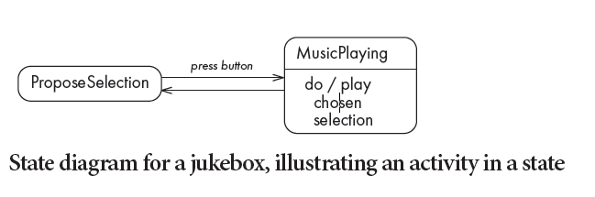
State diagram – an example with activity

Slide 11
Actions in state diagrams
An action is something that takes place effectively instantaneously
When a particular transition is taken,
Upon entry into a particular state, or
Upon exit from a particular state
An action should consume no noticeable amount of time
It should be something simple, such as sending a message, starting a hardware device or setting a variable.

Slide 12
Representation of action
An action is always shown preceded by a slash (‘/’) symbol.
If the action is to be performed during a transition, then the syntax is event/action.
If the action is to be performed when entering or exiting a state, then it is written in the state box with the notation enter/action or exit/action.

Slide 13
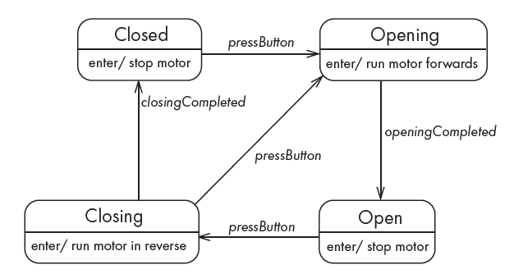
State diagram – an example with actions
State diagram for a garage door opener, showing actions triggered by entry into a state

Slide 14
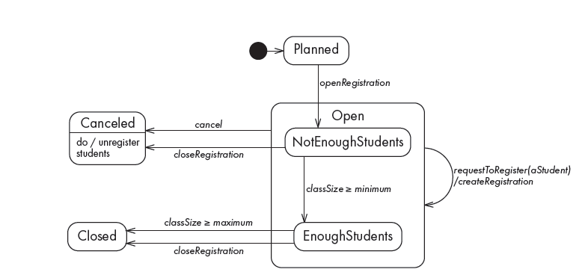
State diagram – an example with substates
A version of the course section example from Figure 8.14, showing the effect of nested states

Slide 15
Activity Diagrams
Activity diagram is another important behavioural diagram in UML diagram to describe dynamic aspects of the system.
The UML activity diagram supplements the use case by providing a graphical representation of the flow of interaction within a specific scenario.
Activity diagram is essentially an advanced version of flow chart that modelling the flow from one activity to another activity.
An activity diagram is like a state diagram.
Except most transitions are caused by internal events, such as the completion of a computation.

Slide 16
Activity Diagrams.......
An activity diagram
Can be used to understand the flow of work that an object or component performs.
Can also be used to visualize the interrelation and interaction between different use cases.
Is most often associated with several classes.
One of the strengths of activity diagrams is the representation of concurrent activities.

Slide 17
Activity Diagram Notation
Activity diagram uses rounded rectangles to imply a specific system function
Arrows to represent flow through the system.
Decision diamonds to depict a branching decision (each arrow emanating from the diamond is labelled).
Solid horizontal lines to indicate that parallel activities are occurring.

Slide 18
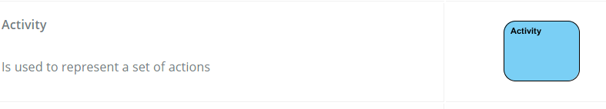
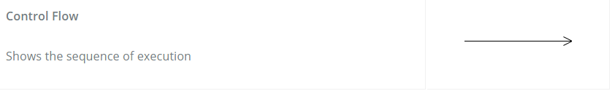
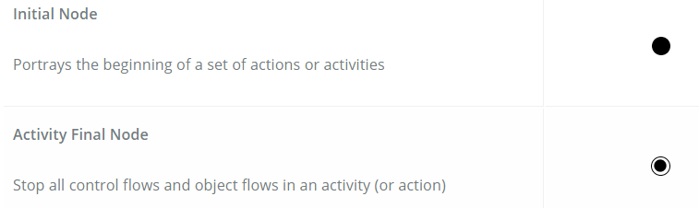
Activity Diagram Notation …..

Slide 19
Decision nodes and merge nodes
An activity diagram has two types of nodes for branching within a single thread. These are represented as small diamonds:
■ Decision node
has one incoming transition and multiple outgoing transitions each with a Boolean guard in square brackets. Exactly one of the outgoing transitions will be taken.
■ Merge node
has two incoming transitions and one outgoing transition. It is used to bring together paths that had been split by decision nodes.

Slide 20
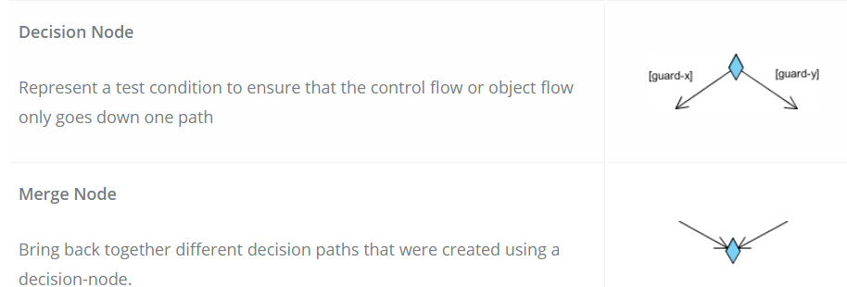
Activity Diagram Notation …..

Slide 21
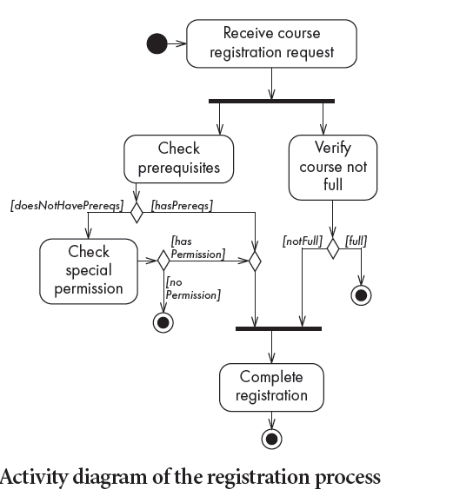
Activity diagrams – an example

Slide 22
Representing concurrency
Concurrency is shown using forks, joins and rendezvous.
A fork has one incoming transition and multiple outgoing transitions.
The execution splits into two concurrent threads.
A rendezvous has multiple incoming and multiple outgoing transitions.
Once all the incoming transitions occur all the outgoing transitions may occur.

Slide 23
Representing concurrency
A join has multiple incoming transitions and one outgoing transition.
The outgoing transition will be taken when all incoming transitions have occurred.
The incoming transitions must be triggered in separate threads.
If one incoming transition occurs, a wait condition occurs at the join until the other transitions occur.

Slide 24
Swimlanes
Activity diagrams are most often associated with several classes.
The partition of activities among the existing classes can be explicitly shown in an activity diagram by the introduction of swimlanes.
Allows you to represent the flow of activities described by the use case
indicate which actor or analysis class has responsibility for the action described by an activity rectangle.
Responsibilities are represented as parallel segments that divide the diagram vertically, like the lanes in a swimming pool.

Slide 25
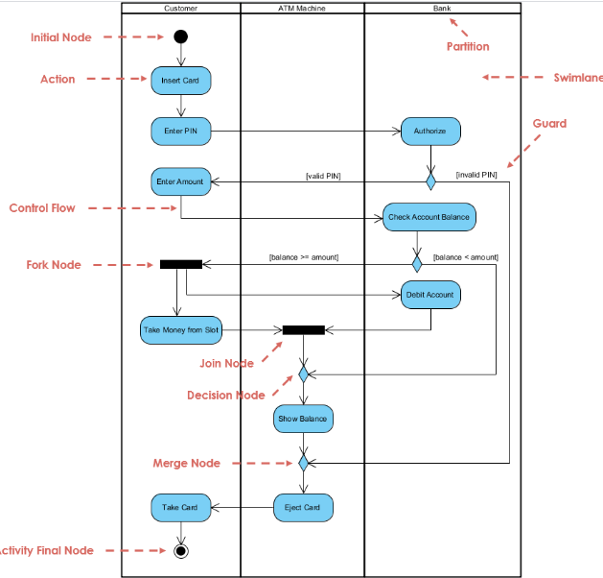

Slide 26
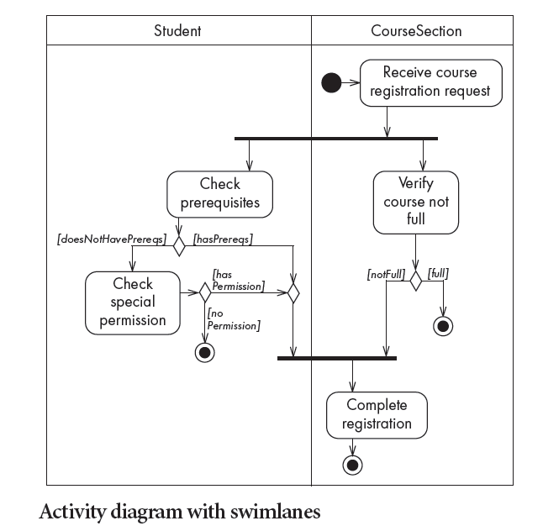
Activity diagrams – an example with swimlanes

